Slide 1
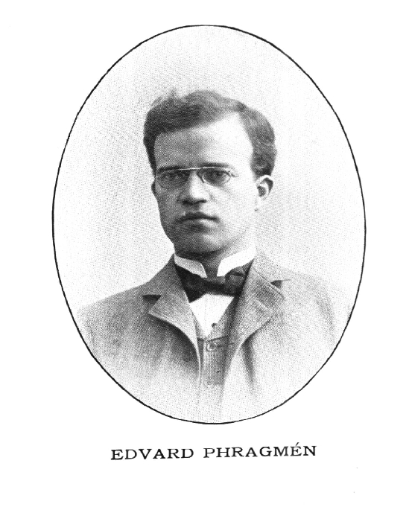
Phragmén’s Sequential Rule (1894)
It costs $1 to elect a candidate to the committee.
Each voter has a virtual bank account, initially empty.
We slowly fill up the bank accounts until some candidate has supporters who have $1 in total.
We elect such a candidate and take the supporters’ money away.
Finish when k candidates have been elected.

Slide 2
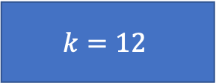
$$k=12$$
4 | 5 | 6 | 10 | 14 | 18
3 |  |  | 9 | 13 | 17
2 |  |  | 8 | 12 | 16
1 |  |  | 7 | 11 | 15
$$v_{1}$$ | $$v_{2}$$ | $$v_{3}$$ | $$v_{4}$$ | $$v_{5}$$ | $$v_{6}$$
4 | 5 | 6 | 10 | 14 | 18
3 |  |  | 9 | 13 | 17
2 |  |  | 8 | 12 | 16
1 |  |  | 7 | 11 | 15
$$v_{1}$$ | $$v_{2}$$ | $$v_{3}$$ | $$v_{4}$$ | $$v_{5}$$ | $$v_{6}$$

Slide 3
$$k=12$$
4 | 5 | 6 | 10 | 14 | 18
3 |  |  | 9 | 13 | 17
2 |  |  | 8 | 12 | 16
1 |  |  | 7 | 11 | 15
$$v_{1}$$ | $$v_{2}$$ | $$v_{3}$$ | $$v_{4}$$ | $$v_{5}$$ | $$v_{6}$$
4 | 5 | 6 | 10 | 14 | 18
3 |  |  | 9 | 13 | 17
2 |  |  | 8 | 12 | 16
1 |  |  | 7 | 11 | 15
$$v_{1}$$ | $$v_{2}$$ | $$v_{3}$$ | $$v_{4}$$ | $$v_{5}$$ | $$v_{6}$$

Slide 4
$$k=12$$
4 | 5 | 6 | 10 | 14 | 18
3 |  |  | 9 | 13 | 17
2 |  |  | 8 | 12 | 16
1 |  |  | 7 | 11 | 15
$$v_{1}$$ | $$v_{2}$$ | $$v_{3}$$ | $$v_{4}$$ | $$v_{5}$$ | $$v_{6}$$
4 | 5 | 6 | 10 | 14 | 18
3 |  |  | 9 | 13 | 17
2 |  |  | 8 | 12 | 16
1 |  |  | 7 | 11 | 15
$$v_{1}$$ | $$v_{2}$$ | $$v_{3}$$ | $$v_{4}$$ | $$v_{5}$$ | $$v_{6}$$

Slide 5
$$k=12$$
4 | 5 | 6 | 10 | 14 | 18
3 |  |  | 9 | 13 | 17
2 |  |  | 8 | 12 | 16
1 |  |  | 7 | 11 | 15
$$v_{1}$$ | $$v_{2}$$ | $$v_{3}$$ | $$v_{4}$$ | $$v_{5}$$ | $$v_{6}$$
4 | 5 | 6 | 10 | 14 | 18
3 |  |  | 9 | 13 | 17
2 |  |  | 8 | 12 | 16
1 |  |  | 7 | 11 | 15
$$v_{1}$$ | $$v_{2}$$ | $$v_{3}$$ | $$v_{4}$$ | $$v_{5}$$ | $$v_{6}$$

Slide 6
$$k=12$$
4 | 5 | 6 | 10 | 14 | 18
3 |  |  | 9 | 13 | 17
2 |  |  | 8 | 12 | 16
1 |  |  | 7 | 11 | 15
$$v_{1}$$ | $$v_{2}$$ | $$v_{3}$$ | $$v_{4}$$ | $$v_{5}$$ | $$v_{6}$$
4 | 5 | 6 | 10 | 14 | 18
3 |  |  | 9 | 13 | 17
2 |  |  | 8 | 12 | 16
1 |  |  | 7 | 11 | 15
$$v_{1}$$ | $$v_{2}$$ | $$v_{3}$$ | $$v_{4}$$ | $$v_{5}$$ | $$v_{6}$$

Slide 7
$$k=12$$
4 | 5 | 6 | 10 | 14 | 18
3 |  |  | 9 | 13 | 17
2 |  |  | 8 | 12 | 16
1 |  |  | 7 | 11 | 15
$$v_{1}$$ | $$v_{2}$$ | $$v_{3}$$ | $$v_{4}$$ | $$v_{5}$$ | $$v_{6}$$
4 | 5 | 6 | 10 | 14 | 18
3 |  |  | 9 | 13 | 17
2 |  |  | 8 | 12 | 16
1 |  |  | 7 | 11 | 15
$$v_{1}$$ | $$v_{2}$$ | $$v_{3}$$ | $$v_{4}$$ | $$v_{5}$$ | $$v_{6}$$

Slide 8
$$k=12$$
4 | 5 | 6 | 10 | 14 | 18
3 |  |  | 9 | 13 | 17
2 |  |  | 8 | 12 | 16
1 |  |  | 7 | 11 | 15
$$v_{1}$$ | $$v_{2}$$ | $$v_{3}$$ | $$v_{4}$$ | $$v_{5}$$ | $$v_{6}$$
4 | 5 | 6 | 10 | 14 | 18
3 |  |  | 9 | 13 | 17
2 |  |  | 8 | 12 | 16
1 |  |  | 7 | 11 | 15
$$v_{1}$$ | $$v_{2}$$ | $$v_{3}$$ | $$v_{4}$$ | $$v_{5}$$ | $$v_{6}$$

Slide 9
$$k=12$$
4 | 5 | 6 | 10 | 14 | 18
3 |  |  | 9 | 13 | 17
2 |  |  | 8 | 12 | 16
1 |  |  | 7 | 11 | 15
$$v_{1}$$ | $$v_{2}$$ | $$v_{3}$$ | $$v_{4}$$ | $$v_{5}$$ | $$v_{6}$$
4 | 5 | 6 | 10 | 14 | 18
3 |  |  | 9 | 13 | 17
2 |  |  | 8 | 12 | 16
1 |  |  | 7 | 11 | 15
$$v_{1}$$ | $$v_{2}$$ | $$v_{3}$$ | $$v_{4}$$ | $$v_{5}$$ | $$v_{6}$$

Slide 10
$$k=12$$
4 | 5 | 6 | 10 | 14 | 18
3 |  |  | 9 | 13 | 17
2 |  |  | 8 | 12 | 16
1 |  |  | 7 | 11 | 15
$$v_{1}$$ | $$v_{2}$$ | $$v_{3}$$ | $$v_{4}$$ | $$v_{5}$$ | $$v_{6}$$
4 | 5 | 6 | 10 | 14 | 18
3 |  |  | 9 | 13 | 17
2 |  |  | 8 | 12 | 16
1 |  |  | 7 | 11 | 15
$$v_{1}$$ | $$v_{2}$$ | $$v_{3}$$ | $$v_{4}$$ | $$v_{5}$$ | $$v_{6}$$

Slide 11
$$k=12$$
4 | 5 | 6 | 10 | 14 | 18
3 |  |  | 9 | 13 | 17
2 |  |  | 8 | 12 | 16
1 |  |  | 7 | 11 | 15
$$v_{1}$$ | $$v_{2}$$ | $$v_{3}$$ | $$v_{4}$$ | $$v_{5}$$ | $$v_{6}$$
4 | 5 | 6 | 10 | 14 | 18
3 |  |  | 9 | 13 | 17
2 |  |  | 8 | 12 | 16
1 |  |  | 7 | 11 | 15
$$v_{1}$$ | $$v_{2}$$ | $$v_{3}$$ | $$v_{4}$$ | $$v_{5}$$ | $$v_{6}$$

Slide 12
$$k=12$$
4 | 5 | 6 | 10 | 14 | 18
3 |  |  | 9 | 13 | 17
2 |  |  | 8 | 12 | 16
1 |  |  | 7 | 11 | 15
$$v_{1}$$ | $$v_{2}$$ | $$v_{3}$$ | $$v_{4}$$ | $$v_{5}$$ | $$v_{6}$$
4 | 5 | 6 | 10 | 14 | 18
3 |  |  | 9 | 13 | 17
2 |  |  | 8 | 12 | 16
1 |  |  | 7 | 11 | 15
$$v_{1}$$ | $$v_{2}$$ | $$v_{3}$$ | $$v_{4}$$ | $$v_{5}$$ | $$v_{6}$$

Slide 13
$$k=12$$
4 | 5 | 6 | 10 | 14 | 18
3 |  |  | 9 | 13 | 17
2 |  |  | 8 | 12 | 16
1 |  |  | 7 | 11 | 15
$$v_{1}$$ | $$v_{2}$$ | $$v_{3}$$ | $$v_{4}$$ | $$v_{5}$$ | $$v_{6}$$
4 | 5 | 6 | 10 | 14 | 18
3 |  |  | 9 | 13 | 17
2 |  |  | 8 | 12 | 16
1 |  |  | 7 | 11 | 15
$$v_{1}$$ | $$v_{2}$$ | $$v_{3}$$ | $$v_{4}$$ | $$v_{5}$$ | $$v_{6}$$

